Slide 1
EE227 – Digital Logic Design
Lecture 28

Slide 2
Outline
Memory and Programmable Logic
Random Access Memory
Write and Read Operations
Timing Waveforms
Types of RAM

Slide 3
Memory Unit
A memory unit is a device to which binary information is transferred for storage and from which information is retrieved when needed for processing
When data processing takes place, information from memory is transferred to selected registers in the processing unit
Intermediate and final results obtained in the processing unit are transferred back to be stored in memory
Binary information received from an input device is stored in memory, and information transferred to an output device is taken from memory
A memory unit is a collection of cells capable of storing a large quantity of binary information

Slide 4
Read and Write Operations
Write Operation
The process of storing new information into memory is referred to as a memory write operation
Read Operation
The process of transferring the stored information out of memory is referred to as a memory read operation

Slide 5
Types of Memory
There are two types of memories that are used in digital systems
Random Access Memory (RAM)
RAM stores new information for later use
RAM can perform both write and read operations
Read Only Memory (ROM)
ROM is a programmable logic device (PLD)
ROM can perform only the read operation
This means that suitable binary information is already stored inside memory and can be retrieved or read at any time. However, that information cannot be altered by writing

Slide 6
Programmable Logic Device (PLD)
The binary information that is stored within a PLD is specified in some fashion and then embedded within the hardware in a process is referred to as programming the device
The word “programming” here refers to a hardware procedure which specifies the bits that are inserted into the hardware configuration of the device
Some Programmable Devices are:
Read Only Memory (ROM)
Programmable Logic Array (PLA)
Only AND gate is programmable
Programmable Array Logic (PAL)
AND, OR both are programmable
Field Programmable Gate Array (FPGA)
Like a mini computer

Slide 7

Typical Working of a PLD
A PLD is an integrated circuit with internal logic gates connected through electronic paths that behave similarly to fuses
In the original state of the device, all the fuses are intact
Programming the device involves blowing those fuses along the paths that must be removed in order to obtain the particular configuration of the desired logic function
A typical PLD may have hundreds to millions of gates interconnected through hundreds to thousands of internal paths
In order to show the internal logic diagram of such a device in a concise form, it is necessary to employ a special gate symbology applicable to array logic

Slide 8
Random Access Memory (RAM)
A memory unit is a collection of storage cells, together with associated circuits needed to transfer information into and out of a device
The architecture of memory is such that information can be selectively retrieved from any of its internal locations
The time it takes to transfer information to or from any desired random location is always the same—hence the name random‐access memory, abbreviated RAM
In contrast, the time required to retrieve information that is stored on magnetic tape depends on the location of the data

Slide 9
Word
A memory unit stores binary information in groups of bits called words
A word in memory is an entity of bits that move in and out of storage as a unit
A memory word is a group of 1’s and 0’s and may represent a number, an instruction, one or more alphanumeric characters, or any other binary‐coded information
A group of 8 bits is called a byte
Most computer memories use words that are multiples of 8 bits in length
Thus, a 16‐bit word contains two bytes, and a 32‐bit word is made up of four bytes
The capacity of a memory unit is usually stated as the total number of bytes that the unit can store

Slide 10
Communication Between Memory and its Environment
Communication between memory and its environment is achieved through:
Data input lines
The n data input lines provide the information to be stored in memory
Data output lines
The n data output lines supply the information coming out of memory
Address selection lines
The k address lines specify the particular word chosen among the many available
Control lines
Specify the direction of transfer
Read
Read input causes binary data to be transferred out of memory
Write
Write input causes binary data to be transferred into the memory

Slide 11
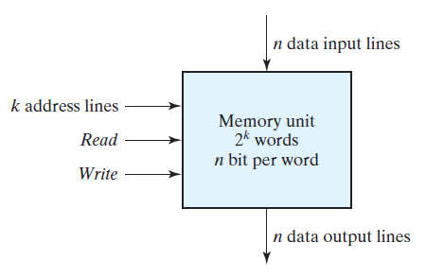
Communication Between Memory and its Environment

Slide 12
Size of Memory and Addresses
The memory unit is specified by the number of words it contains and the number of bits in each word
The address lines select one particular word
Each word in memory is assigned an identification number, called an address, starting from 0 up to 2^{k} - 1,
where k is the number of address lines

Slide 13
Selection of a Particular Address
The selection of a specific word inside memory is done by applying the k ‐bit address to the address lines
An internal decoder accepts this address and opens the paths needed to select the word specified

Slide 14
Relationship Between Words and Address Lines
A memory capable of storing 2^{K} words there must be a K bit address lines
For example
A memory can store 1024 words, how many bits are required in address line?
10 bits
A memory can store 2³² words, how many bits are required in address line?
32 bits

Slide 15
Some Standard Sizes
K Kilo 2¹⁰
M Mega 2²⁰
G Giga 2³⁰
Thus
64K = 2⁶ x 2¹⁰ = 2¹⁶
2M = 2¹ x 2²⁰ = 2²¹
4G = 2² x 2³⁰ = 2³²

Slide 16
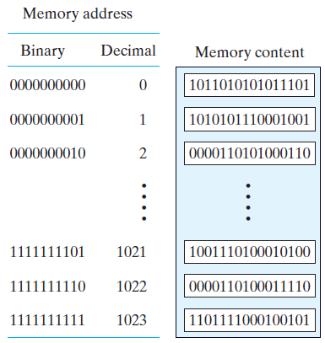
RAM Example
Total 1024 words
16 bits in each word
10 address lines
1024 addresses
First address is 0000000000
Last address is 1111111111
Is called 1K x 16 memory

Slide 17
Practice Problem 1
We have a 64K x 10 RAM. Find:
Total number of addresses
2¹⁶ = 65536
Total bits in each address
16
First Address
00000000 00000000 = 0
Last Address
11111111 11111111 = 65535
Number of bits in each word
10 bits

Slide 18
Practice Problem 2
We have a 4MB RAM. Each word contains 8 bytes.
How many words can such a RAM store?
Total words = (4 x 2²⁰)/8 = (2²²)/(2³) = 2¹⁹
How many bits are required for addressing?
19 bits
How we can represent this RAM?
512K x 64 RAM

Slide 19
Operations of RAM
The two operations that RAM can perform are:
Write Operation
Read Operation
The write signal specifies a transfer‐in operation and the read signal specifies a transfer‐out operation
On accepting one of these control signals, the internal circuits inside the memory provide the desired operation

Slide 20
Write Operation
The steps that must be taken for the purpose of transferring a new word to be stored into memory are as follows:
Apply the binary address of the desired word to the address lines
Apply the data bits that must be stored in memory to the data input lines
Activate the write input
The memory unit will then take the bits from the input data lines and store them in the word specified by the address lines

Slide 21
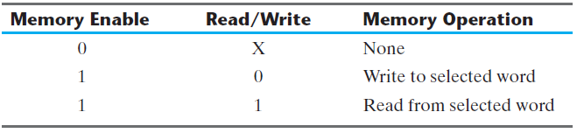
Read Operation
The steps that must be taken for the purpose of transferring a stored word out of memory are as follows:
Apply the binary address of the desired word to the address lines.
Activate the read input
The memory unit will then take the bits from the word that has been selected by the address and apply them to the output data lines
The contents of the selected word do not change after the read operation

Slide 22
Timing Waveforms (1/4)
The operation of the memory unit is controlled by an external device such as a central processing unit (CPU)
The CPU is usually synchronized by its own clock
The memory, however, does not employ an internal clock. Instead, its read and write operations are specified by control inputs
The access time of memory is the time required to select a word and read it
The cycle time of memory is the time required to complete a write operation
The CPU must provide the memory control signals in such a way as to synchronize its internal clocked operations with the read and write operations of memory
This means that the access time and cycle time of the memory must be within a time equal to a fixed number of CPU clock cycles

Slide 23
Timing Waveforms (2/4)
Suppose as an example that a CPU operates with a clock frequency of 50 MHz, giving a period of 20 ns for one clock cycle
Suppose also that the CPU communicates with a memory whose access time and cycle time do not exceed 50 ns
It mean that the write cycle terminates the storage of the selected word within a 50‐ns interval and that the read cycle provides the output data of the selected word within 50 ns or less

Slide 24
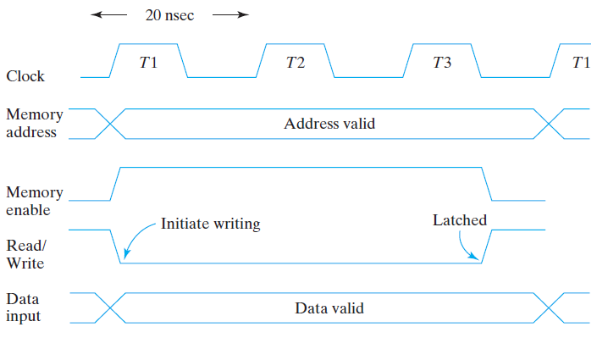
Timing Waveforms (3/4)
Write Cycle

Slide 25
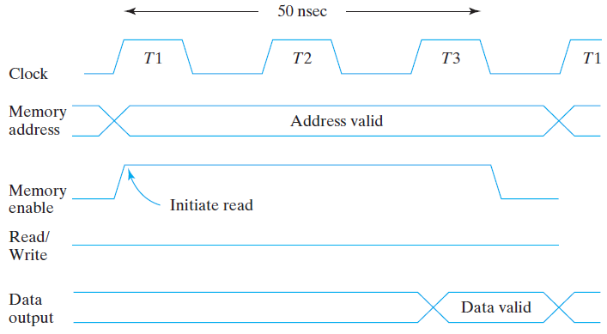
Timing Waveforms (4/4)
Read Cycle

Slide 26
Types of RAM
Integrated circuit RAM units are available in two operating modes
Static RAM
Dynamic RAM

Slide 27
Static RAM
Consists essentially of internal latches that store the binary information
The stored information remains valid as long as power is applied to the unit

Slide 28
Dynamic RAM
Dynamic RAM (DRAM) stores the binary information in the form of electric charges on capacitors provided inside the chip by MOS transistors
The stored charge on the capacitors tends to discharge with time, and the capacitors must be periodically recharged by refreshing the dynamic memory
Refreshing is done by cycling through the words every few milliseconds to restore the decaying charge
DRAM offers reduced power consumption and larger storage capacity in a single memory chip
SRAM is easier to use and has shorter read and write cycles

Slide 29
Volatile and Non Volatile Memory
Volatile
Memory units that lose stored information when power is turned off are said to be volatile
CMOS integrated circuit RAMs, both static and dynamic, are of this category, since the binary cells need external power to maintain the stored information
Non Volatile
Nonvolatile memory, such as magnetic disk, retains its stored information after the removal of power
ROM is another nonvolatile memory
A nonvolatile memory enables digital computers to store programs that will be needed again after the computer is turned on

Slide 30
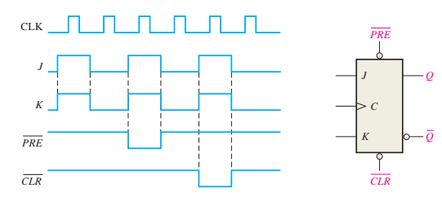
Determine the Q waveform relative to the clock if the signals shown in Figure are applied to the inputs of the J-K flip-flop. Assume that Q is initially LOW.

Slide 31
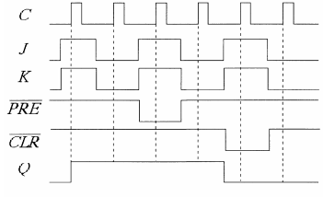

Slide 32
In the shipping department of a softball factory, the balls roll down a conveyor and through a chute single file into boxes for shipment. Each ball passing through the chute activates a switch circuit that produces an electrical pulse. The capacity of each box is 32 balls. Design a logic circuit to indicate when a box is full so that an empty box can be moved into position.

Slide 33
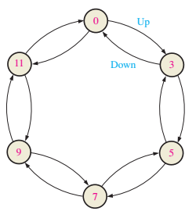
Design a binary counter with the sequence shown in the state diagram

Slide 34

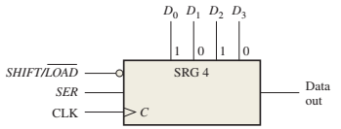
The shift register in Figure has SHIFT/LOAD and CLK inputs as shown. The serial data input (SER) is a 0. The parallel data inputs are D0 = 1, D1 = 0, D2 = 1, and D3 = 0 as shown. Develop the data-output waveform in relation to the inputs

Slide 35
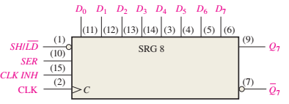
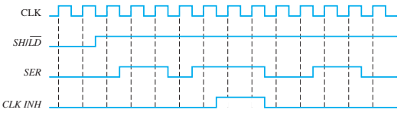
The waveforms in Figure are applied to a 74HC165 shift register. The parallel inputs are all 0. Determine the Q7 waveform
.

